Slide 1
Hotel Hotline Bling
Hotel System
10/12/2018
Griffin, Moriah, Jim

Slide 2
Description
Our project will simulate hotel reservations and other activities available such as a restaurant reservations that feature a clerk less and self-service experience for a potential customer. Our system is a physical kiosk at a desired location. Reservations can be made across the country [United States] and can accommodate pets. Customers will be given the option of what rooms they want according to individual need and given the option of payment upfront or at location. Continental breakfast is optional. Parking is available. Cancellations will be charged unless done within two weeks of time of stay.

Slide 3
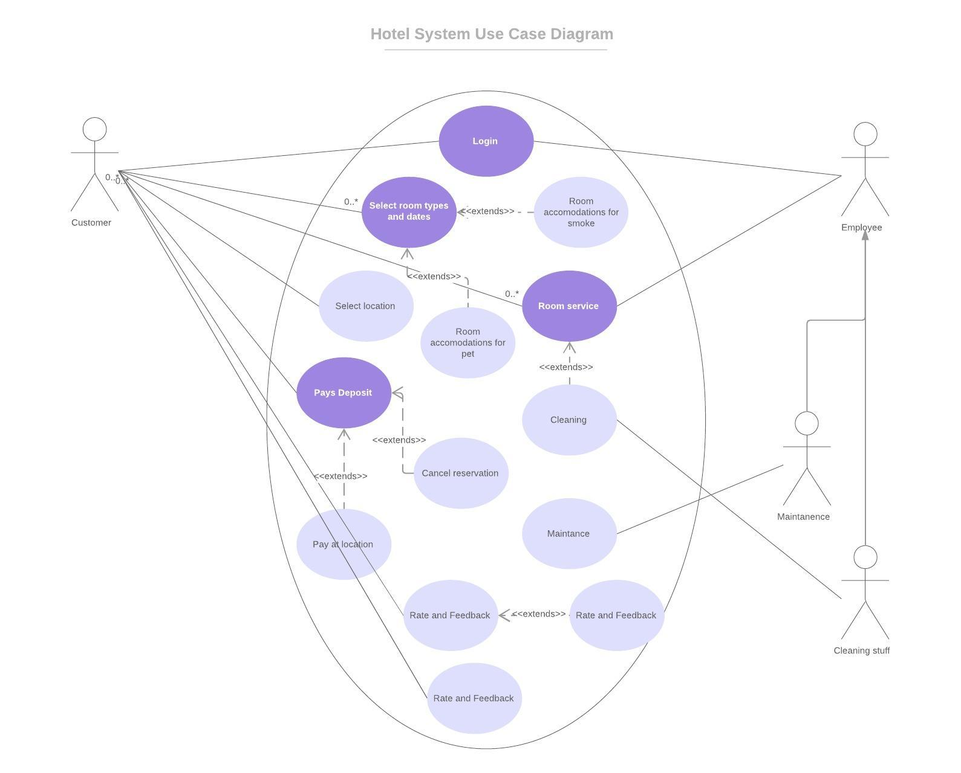
Use Case Diagram

Slide 4
Purpose
The purpose of this program is to provide the user with a clerkless hotel service complete with self check-in, check-out, and self pay. This is useful because it provides a quick and easy way to get a hotel room.

Slide 5
Platform
Our software needs minimum requirements to use and will be implemented using a touch-screen kiosk.

Slide 6
Intended Audience
We plan on constructing the system as a kiosk for the use of customers and additionally an interface used for employees to manage their hours, displays schedule and gives the option to request for time off, which will need approval from administrative positions

Slide 7
Team Dynamic
Meet monday, wed, or fri from ~12-4
Moriah will be in charge of the schedule
Griffin will be in charge of code
Jim will be in charge of design

